Slide 1
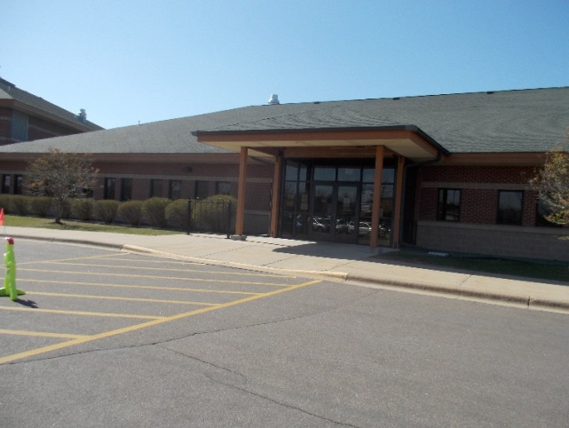
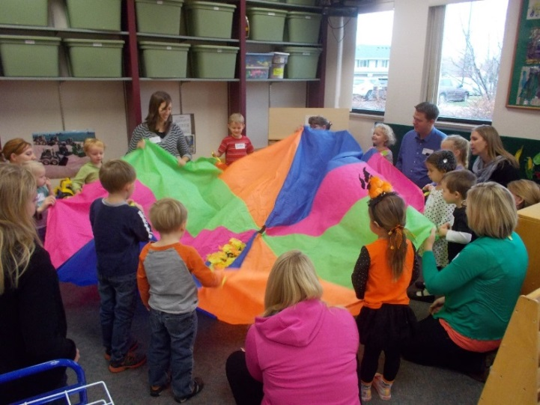
A Typical ECFE Class in Northfield

Slide 2
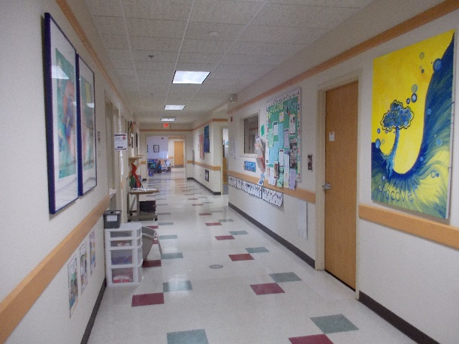
Typical Daily Schedule Average class time: 1.5 hours
Welcome!
Interactive play, art and activities with caregivers (30 minutes)
Circle time with caregivers (15 minutes)
Snack while caregivers separate
Adults take time to talk with other adults and facilitated discussions with a parent educator for (45 minutes)
Children have time to explore and learn together with an early childhood teacher
Closing circle and goodbyes!

Slide 3
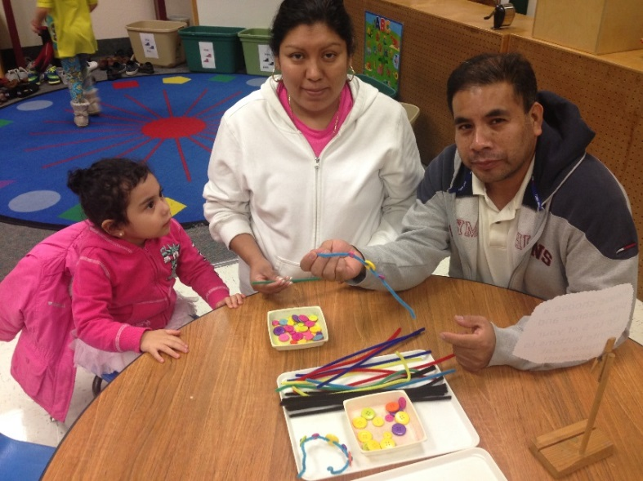
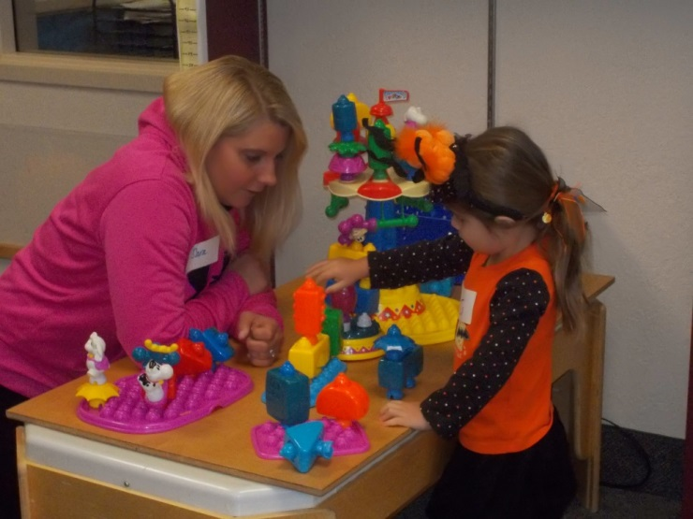
Play time with caregivers

Slide 4
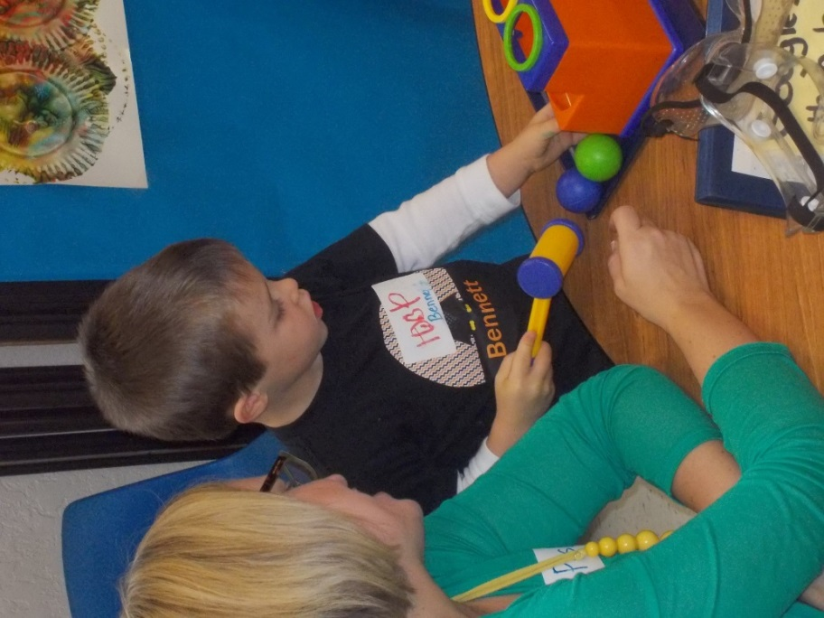
Exploration time!

Slide 5
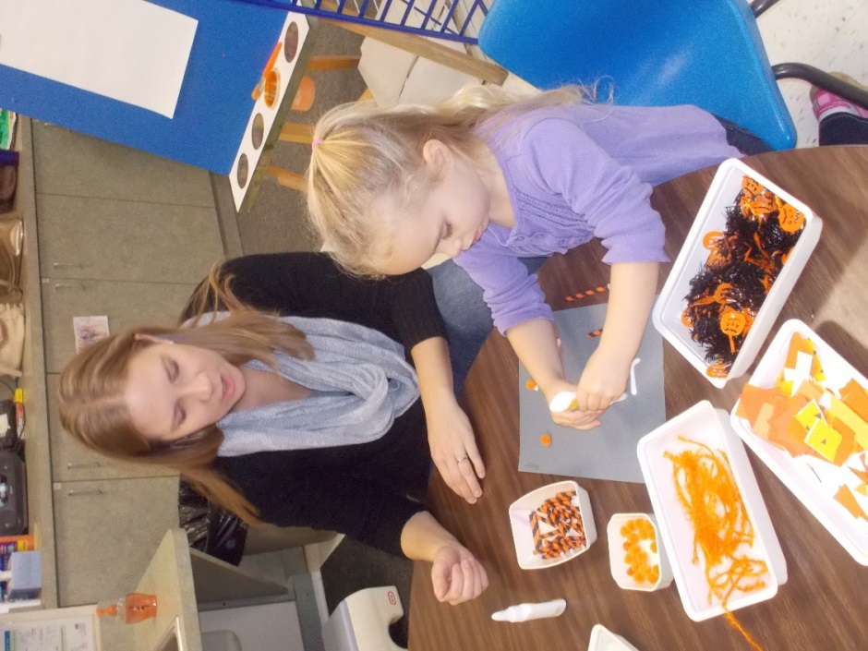
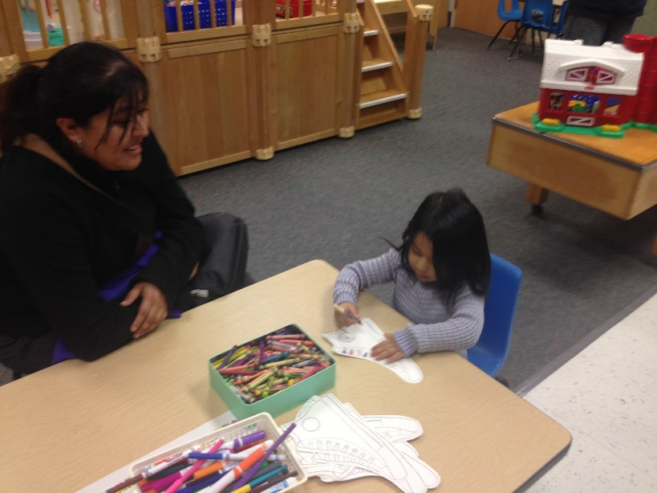
Art Fun

Slide 6
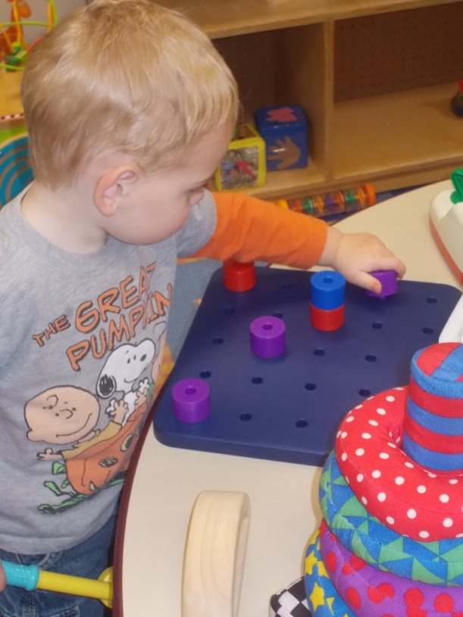
Young Explorers

Slide 7
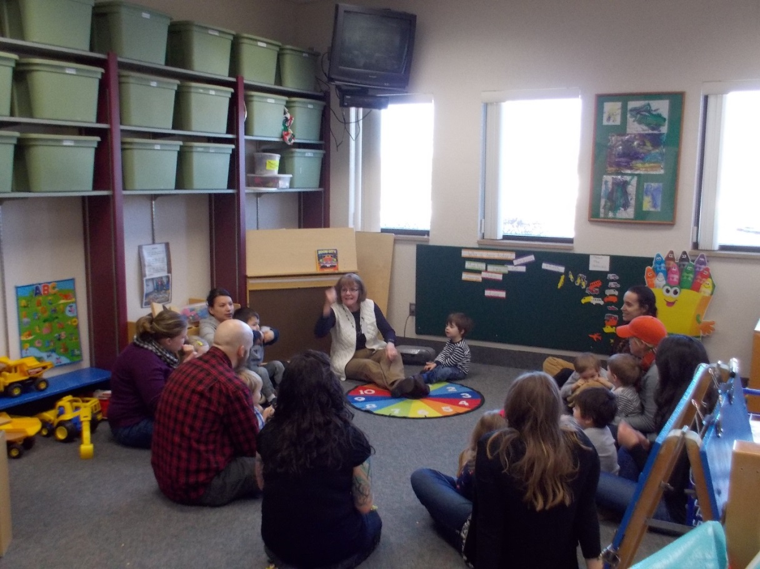
Circle time with caregivers

Slide 8
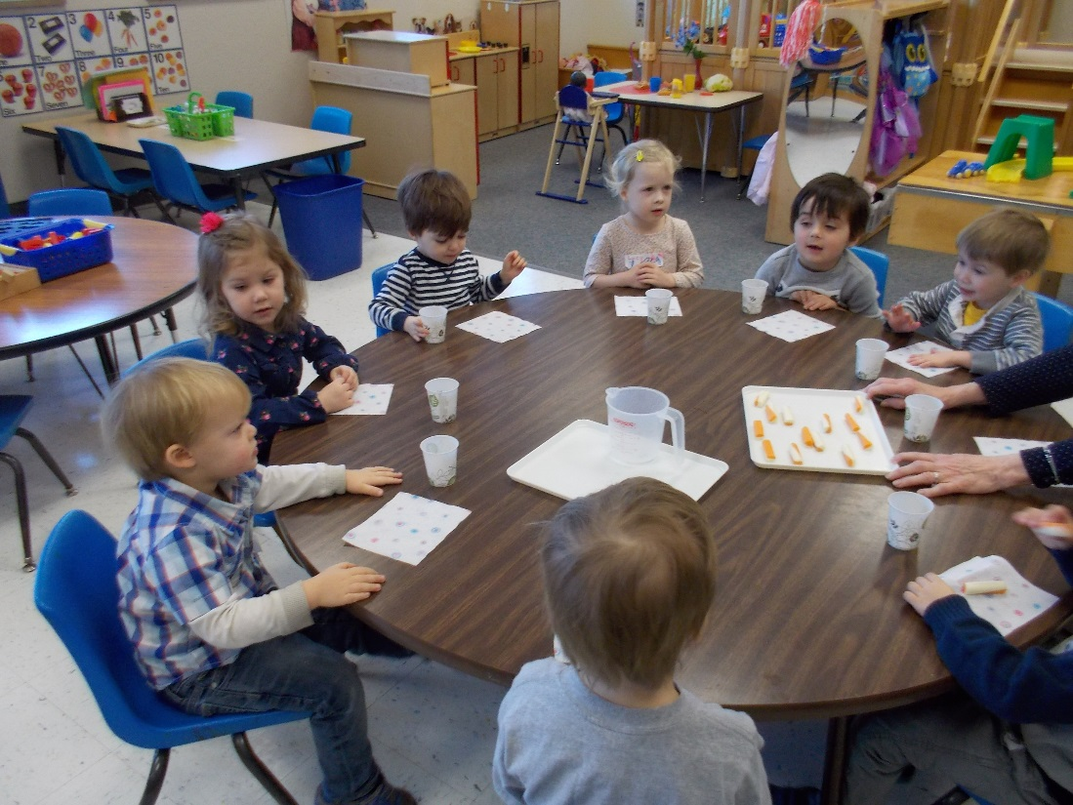
Snack Time as parents separate for discussion time

Slide 9
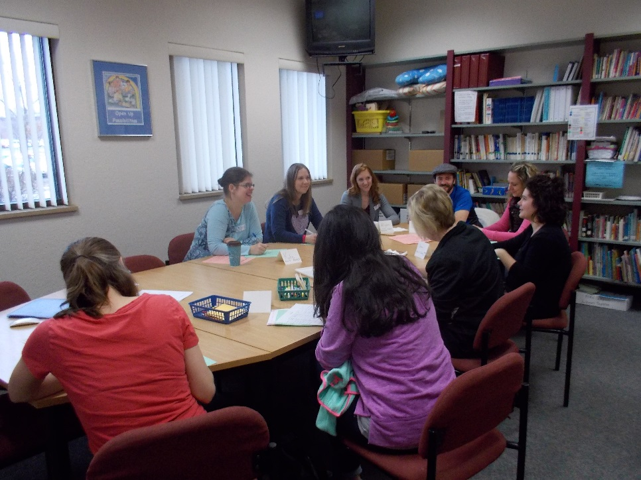
Parent Discussion Time

Slide 10
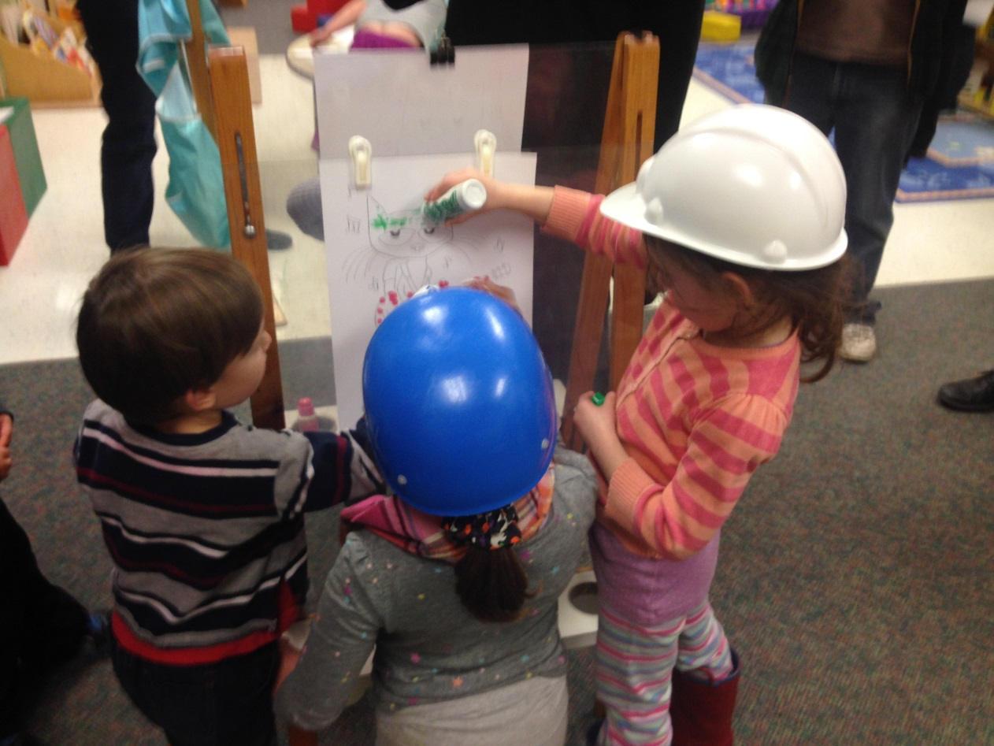
Exploration with friends

Slide 11
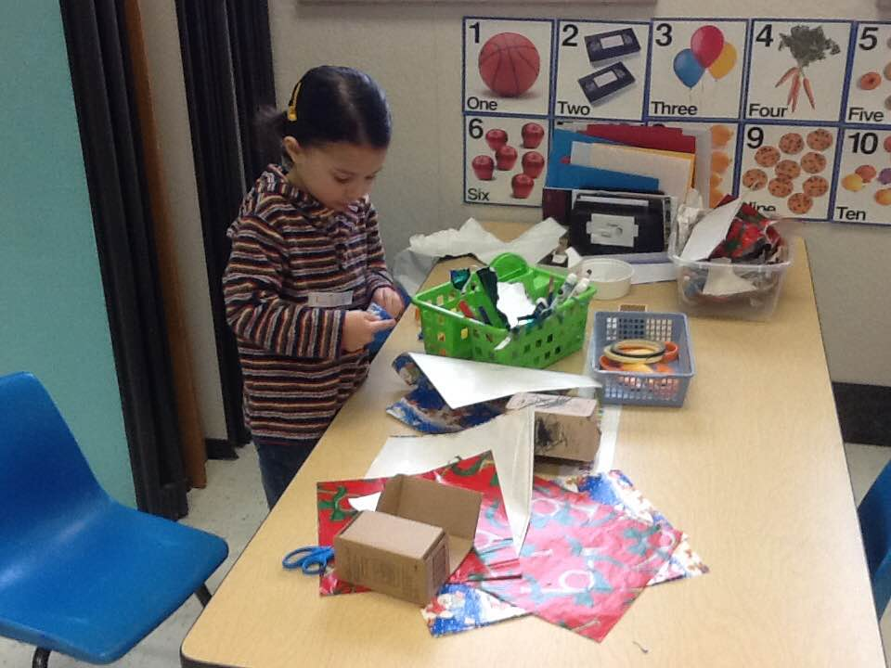
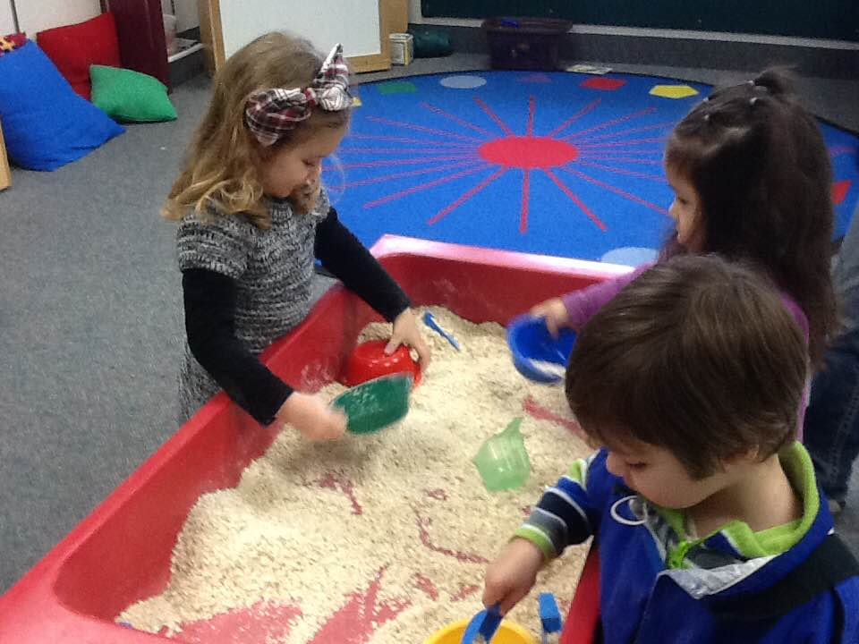
More Exploration, Play and Learning!

Slide 12
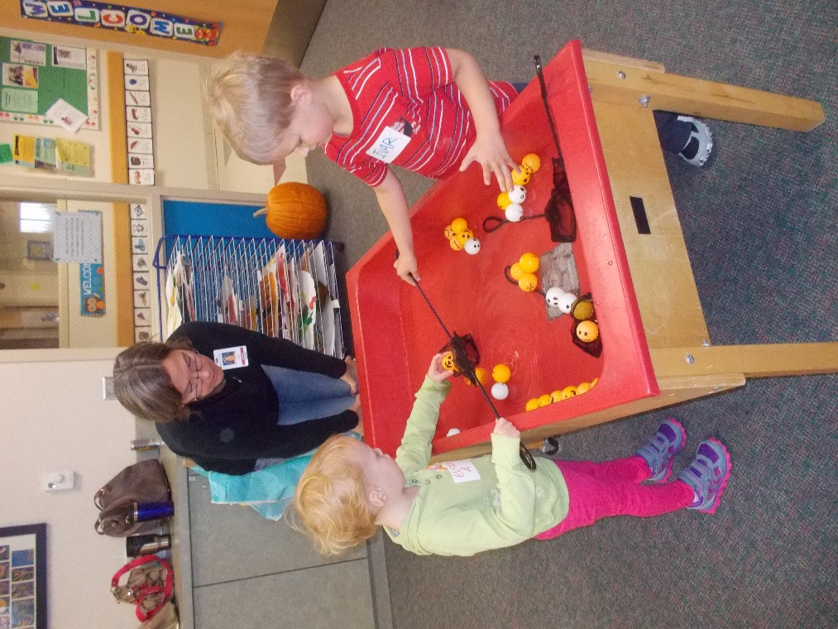
Fun with Early Childhood Staff

Slide 13
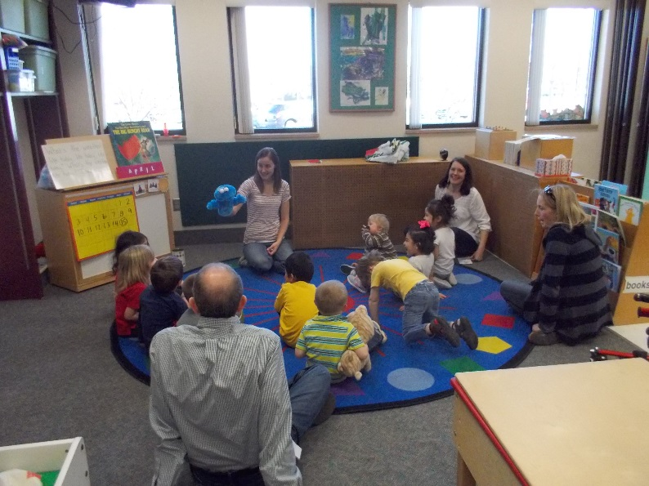
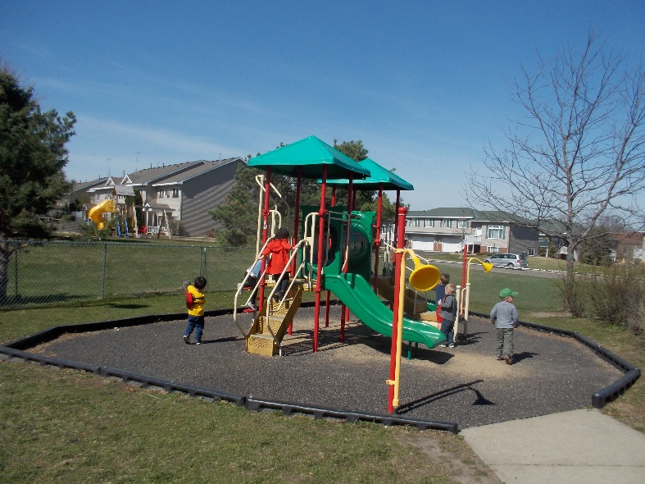
Ending Circle Time and Goodbyes!

Slide 14
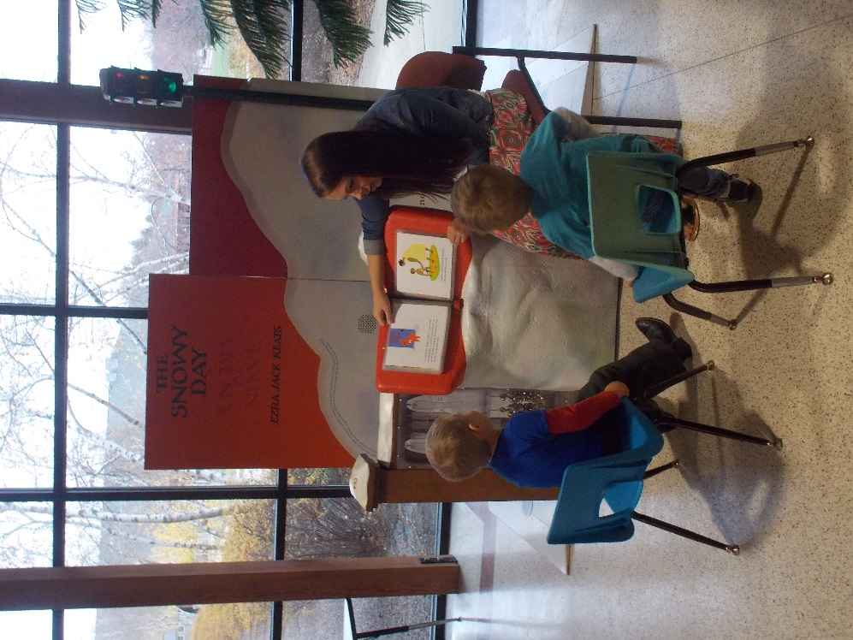
Special Events and Visits

Slide 15
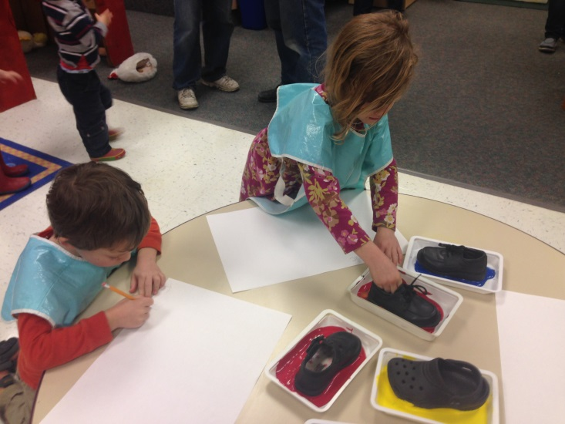
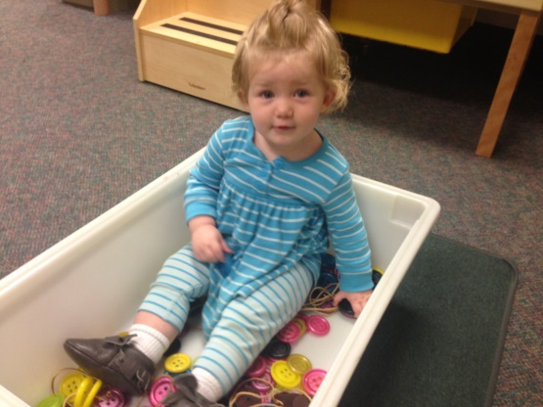
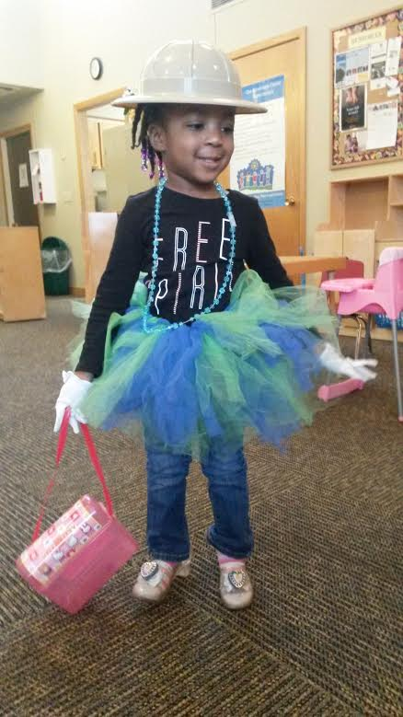
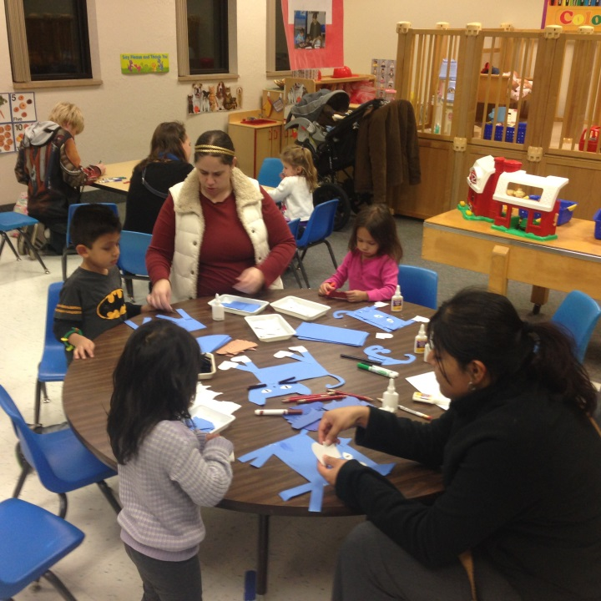
Other ECFE offerings
On my own preschool class
Evening and weekend classes, one night or more!
Drop in Playtime classes
Off-site classes

Slide 16
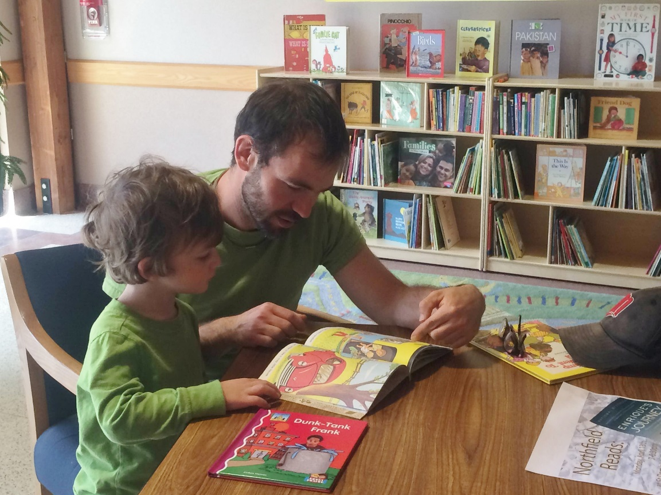
ECFE, a great place to be!

